Slide 1
Comparing several means: ANOVA (GLM 1)
Prof. Andy Field

Slide 2
Aims
Understand the basic principles of ANOVA
Why it is done?
What it tells us?
Theory of one-way independent ANOVA
Following up an ANOVA:
Planned Contrasts/Comparisons
Choosing Contrasts
Coding Contrasts
Post Hoc Tests

Slide 3
When And Why
When we want to compare means we can use a t-test. This test has limitations:
You can compare only 2 means: often we would like to compare means from 3 or more groups.
It can be used only with one Predictor/Independent Variable.
ANOVA
Compares several means.
Can be used when you have manipulated more than one Independent Variables.
It is an extension of regression (the General Linear Model)

Slide 4
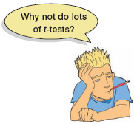
Why Not Use Lots of t-Tests?
If we want to compare several means why don’t we compare pairs of means with t-tests?
Can’t look at several independent variables.
Inflates the Type I error rate.
1
1
2
Vs
1
3
Vs
2
3
2
Vs
3

Slide 5
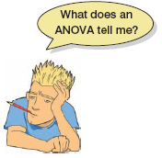
What Does ANOVA Tell us?
Null Hyothesis:
Like a t-test, ANOVA tests the null hypothesis that the means are the same.
Experimental Hypothesis:
The means differ.
ANOVA is an Omnibus test
It test for an overall difference between groups.
It tells us that the group means are different.
It doesn’t tell us exactly which means differ.

Slide 6
ANOVA as Regression

Slide 7
Placebo Group

Slide 8
High Dose Group

Slide 9
Low Dose Group

Slide 10
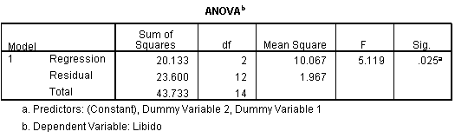
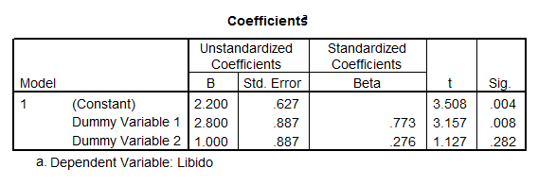
Output from Regression

Slide 11
Experiments vs. Correlation
ANOVA in Regression:
Used to assess whether the regression model is good at predicting an outcome.
ANOVA in Experiments:
Used to see whether experimental manipulations lead to differences in performance on an outcome (DV).
By manipulating a predictor variable can we cause (and therefore predict) a change in behaviour?
Asking the same question, but in experiments we systematically manipulate the predictor, in regression we don’t.

Slide 12
Theory of ANOVA
We calculate how much variability there is between scores
Total Sum of squares (SS_{T}).
We then calculate how much of this variability can be explained by the model we fit to the data
How much variability is due to the experimental manipulation, Model Sum of Squares (SS_{M})...
… and how much cannot be explained
How much variability is due to individual differences in performance, Residual Sum of Squares (SS_{R}).

Slide 13

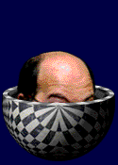
Rationale to Experiments
Group 1
Group 2
Lecturing Skills
Variance created by our manipulation
Removal of brain (systematic variance)
Variance created by unknown factors
E.g. Differences in ability (unsystematic variance)

Slide 14
Population
μ = 10
No Experiment
M = 10
M = 9
M = 11
M = 10
M = 9
M = 8
M = 12
M = 10
M = 11
Experiment

Slide 15
Theory of ANOVA
We compare the amount of variability explained by the Model (experiment), to the error in the model (individual differences)
This ratio is called the F-ratio.
If the model explains a lot more variability than it can’t explain, then the experimental manipulation has had a significant effect on the outcome (DV).

Slide 16
Theory of ANOVA
If the experiment is successful, then the model will explain more variance than it can’t
SS_{M} will be greater than SS_{R}

Slide 17
ANOVA by Hand
Testing the effects of Viagra on Libido using three groups:
Placebo (Sugar Pill)
Low Dose Viagra
High Dose Viagra
The Outcome/Dependent Variable (DV) was an objective measure of Libido.

Slide 18
The Data

Slide 19
The data:

Slide 21
Step 1: Calculate SS_{T}

Slide 22
Degrees of Freedom (df)
Degrees of Freedom (df) are the number of values that are free to vary.
Think about Rugby Teams!
In general, the df are one less than the number of values used to calculate the SS.

Slide 23
Step 2: Calculate SS_{M}

Slide 24
Model Degrees of Freedom
How many values did we use to calculate SS_{M}?
We used the 3 means.

Slide 25
Step 3: Calculate SS_{R}

Slide 26
Step 3: Calculate SS_{R}

Slide 27
Residual Degrees of Freedom
How many values did we use to calculate SS_{R}?
We used the 5 scores for each of the SS for each group.

Slide 28
Double Check

Slide 29
Step 4: Calculate the Mean Squared Error

Slide 30
Step 5: Calculate the F-Ratio

Slide 31
Step 6: Construct a Summary Table
Source | SS | df | MS | F
Model | 20.14 | 2 | 10.067 | 5.12*
Residual | 23.60 | 12 | 1.967
Total | 43.74 | 14

Slide 32
Why Use Follow-Up Tests?
The F-ratio tells us only that the experiment was successful
i.e. group means were different
It does not tell us specifically which group means differ from which.
We need additional tests to find out where the group differences lie.

Slide 33
How?
Multiple t-tests
We saw earlier that this is a bad idea
Orthogonal Contrasts/Comparisons
Hypothesis driven
Planned a priori
Post Hoc Tests
Not Planned (no hypothesis)
Compare all pairs of means
Trend Analysis

Slide 34
Planned Contrasts
Basic Idea:
The variability explained by the Model (experimental manipulation, SS_{M}) is due to participants being assigned to different groups.
This variability can be broken down further to test specific hypotheses about which groups might differ.
We break down the variance according to hypotheses made a priori (before the experiment).
It’s like cutting up a cake (yum yum!)

Slide 35
Rules When Choosing Contrasts
Independent
contrasts must not interfere with each other (they must test unique hypotheses).
Only 2 Chunks
Each contrast should compare only 2 chunks of variation (why?).
K-1
You should always end up with one less contrast than the number of groups.

Slide 36
Generating Hypotheses
Example: Testing the effects of Viagra on Libido using three groups:
Placebo (Sugar Pill)
Low Dose Viagra
High Dose Viagra
Dependent Variable (DV) was an objective measure of Libido.
Intuitively, what might we expect to happen?

Slide 37
 | Placebo | Low Dose | High Dose
 | 3 | 5 | 7
 | 2 | 2 | 4
 | 1 | 4 | 5
 | 1 | 2 | 3
 | 4 | 3 | 6
Mean | 2.20 | 3.20 | 5.00

Slide 38
How do I Choose Contrasts?
Big Hint:
In most experiments we usually have one or more control groups.
The logic of control groups dictates that we expect them to be different to groups that we’ve manipulated.
The first contrast will always be to compare any control groups (chunk 1) with any experimental conditions (chunk 2).

Slide 39
Hypotheses
Hypothesis 1:
People who take Viagra will have a higher libido than those who don’t.
Placebo ≠ (Low, High)
Hypothesis 2:
People taking a high dose of Viagra will have a greater libido than those taking a low dose.
Low ≠ High

Slide 40
Planned Comparisons

Slide 41
Another Example

Slide 42
Another Example

Slide 43
Coding Planned Contrasts: Rules
Rule 1
Groups coded with positive weights compared to groups coded with negative weights.
Rule 2
The sum of weights for a comparison should be zero.
Rule 3
If a group is not involved in a comparison, assign it a weight of zero.

Slide 44
Coding Planned Contrasts: Rules
Rule 4
For a given contrast, the weights assigned to the group(s) in one chunk of variation should be equal to the number of groups in the opposite chunk of variation.
Rule 5
If a group is singled out in a comparison, then that group should not be used in any subsequent contrasts.

Slide 45
Defining Contrasts Using Weights

Slide 47
Output

Slide 48
Post Hoc Tests
Compare each mean against all others.
In general terms they use a stricter criterion to accept an effect as significant.
Hence, control the familywise error rate.
Simplest example is the Bonferroni method:

Slide 49
Post Hoc Tests Recommendations:
SPSS has 18 types of Post hoc Test!
Field (2013):
Assumptions met:
REGWQ or Tukey HSD.
Safe Option:
Bonferroni.
Unequal Sample Sizes:
Gabriel’s (small n), Hochberg’s GT2 (large n).
Unequal Variances:
Games-Howell.

Slide 50
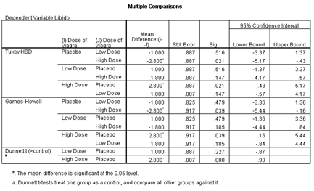
Post Hoc Test Output

Slide 51
Trend Analysis

Slide 52
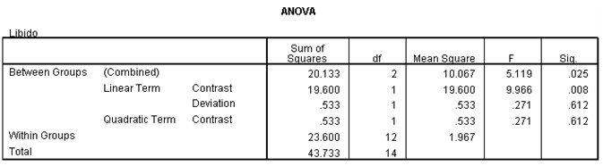
Trend Analysis: Output

Slide 53
Trend Analysis: Output II

Slide 54
Reporting Results
There was a significant effect of Viagra on levels of libido, F(2, 12) = 5.12, p = .025, ω= .60.
There was a significant linear trend, F(1, 12) = 9.97, p = .008, ω= .62, indicating that as the dose of Viagra increased, libido increased proportionately.

Slide 55
Reporting Results Continued
Planned contrasts revealed that having any dose of Viagra significantly increased libido compared to having a placebo, t(12) = 2.47, p = .029, r = .58, but having a high dose did not significantly increase libido compared to having a low dose, t(12) = 2.03, p = .065, r = .51.

